Slide 1
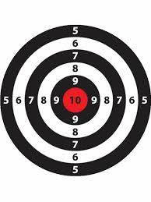
Segmentation, Targeting and Positioning
Dr Jenny Lloyd
Associate Professor in Marketing
Term 1

Slide 2
Session objectives
Define the concepts of segmentation, targeting and positioning
Understand the purpose and reflect upon the value of segmentation, targeting and positioning strategy
Understand the value of segmentation, targeting and positioning strategy.
Analyse the value that effective STP strategy can have for product/service formulation and consumer/customer satisfaction

Slide 3
So what do we know so far?
Markets (and therefore competitors) should be defined according to the nature of the needs satisfied.
In order to have an effective market orientation, organisations should maintain an understanding of their marketing environment through a process of market scanning and environmental analysis.
Customer and consumer choice is influenced by both internal factors (i.e. self concept) and external factors (i.e. culture, reference groups etc).
Understanding the nature of consumer need and the process of decision-making is essential for marketers as it allows them to tailor their products and services and communicate their value in a way (and at a time) that is meaningful.

Slide 4

But is it possible or even desirable to target everyone?

Slide 5
The STP Process
SEGMENTATION
The identification and grouping of individuals or organisations with similar characteristics that have implications for marketing strategy
TARGETING
The choice of which markets to pursue
POSITIONING
Positioning is the identification of a place in the market that responds to the identified consumer/customer need in a way that offers competitive advantage

Slide 6
Why segment…?
Market segmentation
Target market selection
Differentiated strategy
Tailored marketing mix
TOWS/
Critical Success Factors
A KEY STRATEGIC TOOL IN MARKETING STRATEGY

Slide 7

Segmentation and Targeting: how to remember which is which…

Slide 8
THE SEGMENTATION PROCESS
Solomon, Marshall et al (2013)
Understanding the types of needs/requirements in the market
Disaggregated Market
Step 1

Slide 9
THE SEGMENTATION PROCESS
Solomon, Marshall et al (2013)
Understanding the types of needs/requirements in the market
Disaggregated Market
Segmented
Market
Step 1
Grouping according to the requirements and characteristics
Step 2

Slide 10
THE SEGMENTATION PROCESS
Solomon, Marshall et al (2013)
Understanding the types of needs/requirements in the market
Disaggregated Market
Segmented
Market
Targeted Market
Step 1
Grouping according to the requirements and characteristics
Step 2
Choosing a segment to target
Step 2

Slide 11
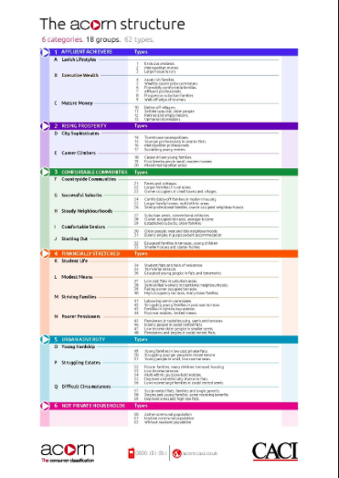
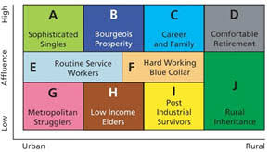
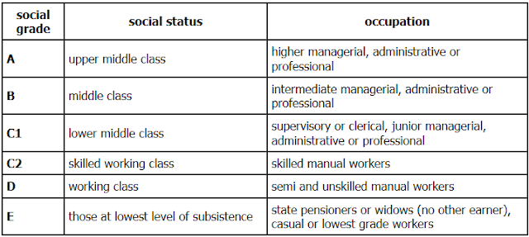
Segmentation bases
Solomon, Marshal et al (2013)
PROFILE
Demographic,
Socio-economic, Geographic
Solomon, Marshall et al (2013)

Slide 12
Segmentation bases
BEHAVIOURAL
Benefits sought, purchase occasion, purchase behaviour, usage
Solomon, Marshall et al (2013)

Slide 13
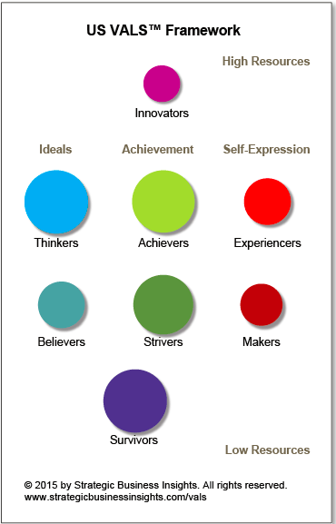
Segmentation bases
PSYCHOGRAPHIC
Values, Lifestyle, Personality

Slide 14
4 Criteria for Successful Segmentation
 | Criteria | Definition
1 | Distinctiveness | Must be clearly distinct from other segments. If not segment boundaries become too blurred and there is a risk that offerings will not be sufficiently well tailored to attract the required customers
2 | Tangibility | A segment must be of a sufficient size to make its pursuit worthwhile.
3 | Accessibility | Accessible both from a distribution and communications points of view.
4 | Defendability | Can the organization develop a sufficiently strong differential advantage?
Solomon, Marshall et al (2013)

Slide 15
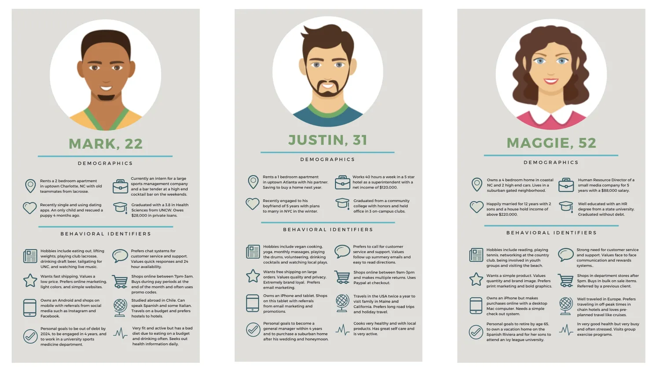
What do you do with this information?
See the async task for how to create customer personas and what goes in them
You create customer personas!

Slide 16
TARGETING: HOW DO YOU DECIDE WHICH IS THE MOST ATTRACTIVE SEGMENT TO TARGET?
How distinct is the segment (ie. is it worth targeting the segment specifically?
Is it possible to measure the size of the segment?
What is the potential for the segment to be profitable now and in the future?
Can marketing communications reach the segment?
Can the organization serve the needs of the segment adequately (and profitably)?
Adapted from Solomon, Marshal et al (2013)

Slide 17
TARGETING STRATEGIES
UNDIFFERENTIATED TARGETING
CONCENTRATED TARGETING
DIFFERENTIATED TARGETING
CUSTOM TARGETING
Adapted from Solomon, Marshal et al (2013)

Slide 18
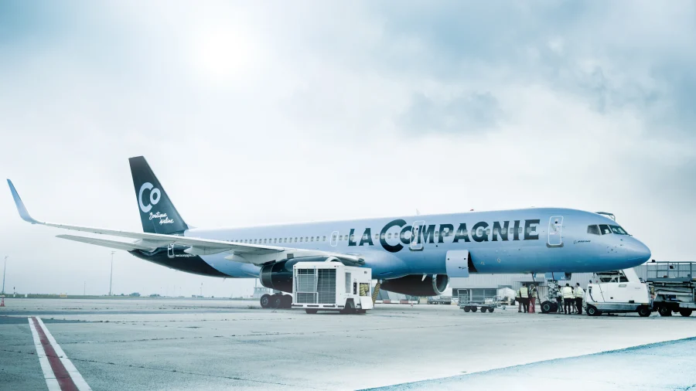


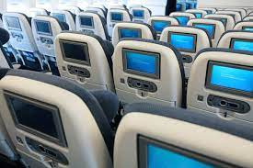

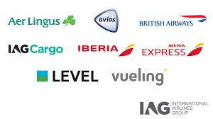
TARGETING STRATEGIES
UNDIFFERENTIATED TARGETING
CONCENTRATED TARGETING
DIFFERENTIATED TARGETING
CUSTOM TARGETING

Slide 19
So, you’ve segmented your market, and identified your preferred target segment – what next?
Analyse competitor positions
Identify the gap in the market
Create a product or service to serve that gap
Positioning…
creating a product/service that is distinctive and unique in the mind of customers/consumers
Adapted from Ries and Trout (1986)

Slide 20
PERCEPTUAL MAPS
Identify the distinguishing attributes within a category
Identify a set of competing brands
Plot each of the brands on a two-dimensional map

Slide 21


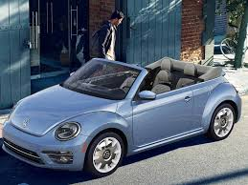
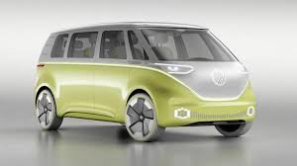
Perceptual Map
Family
Premium
Economy
Sport

Slide 22
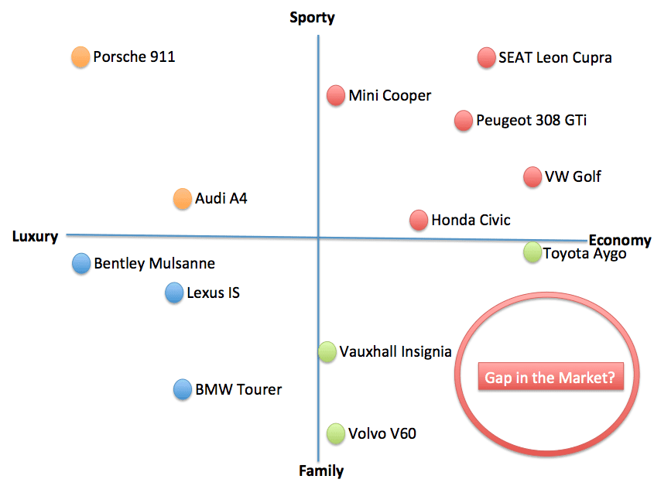

Slide 23
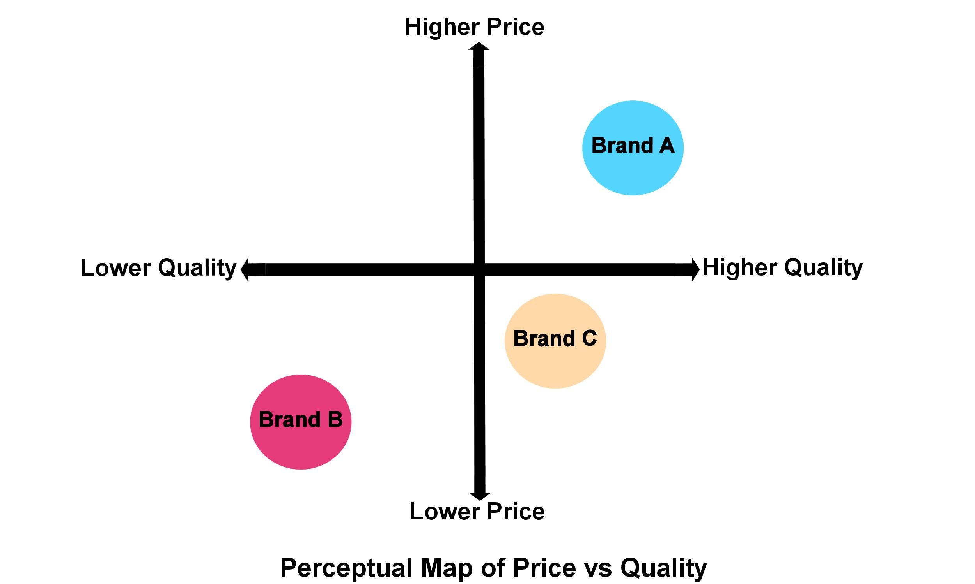
NO NO NO NO NO…………

Slide 24

Perceptual maps
Identifies gaps in the market
Not all gaps are opportunities
Identifies position in the market
Clarifies brand proposition
Identifies potential competitors

Slide 25
Positioning (Ries and Trout 1986)
HOW DO YOU ACHIEVE A UNIQUE POSITION IN THE MIND OF CONSUMERS?
CLARITY
CONSISTENCY
CREDIBILITY
COMPETITIVENESS

Slide 26
Summary
STP strategy is one of the most important tools in the marketing arsenal
Successful STP supports effective allocation of resources and a sustainable business model
Central to effective STP is the ability to understand the market at both a macro and micro level
In particular to understand the drivers of consumer need
The dynamic nature of the market means that successful STP requires ongoing research
…and the ability to develop products and services that uniquely respond to consumer/customer needs and wants.

